Slide 1
Empirical Findings from Research on Decision Making under Risk & Uncertainty

Slide 2

Basic Empirical Findings of Risky Choice

Slide 3
St Petersburg Paradox
Flip a coin
  Heads: continue
  Tails: stop and get $2¹
If heads on first flip, then for second flip
  Heads: continue
  Tails; stop and get $2²
If heads on first n-1 flips, then for n flip
  Heads: continue
  Tails: stop and get $2^{n}

Slide 4
Expected value for St. Petersburg
EV(gamble) = (1/2¹) ⋅2¹ + (1/2²) ⋅2² + …
+ (1/2^{n}) ⋅2^{n}
= infinite
But people are not willing to pay even $10,000 to play.

Slide 5
Daniel Bernoulli (1738)
Introduce the Expected utility model to explain the St. Petersburg Paradox
Initially proposed that Utility of money is a log function of money U(x)=log(x)
More recently researchers often assume utility of money is a power function of money U(x) = xª
  a < 1 risk averse (increasing negative acceleration)
  a =1 risk neutral (increasing zero acceleration)
  a > 1 risk seeking (increasing positive acceleration)

Slide 6
Allais (1953) Paradoxes
See also Kahneman and Tversky (1979)

Slide 7
Common Ratio Effect
(Allais, Kahneman & Tversky)
.16
5M
.80
5M
A’
0M
A
.84
.20
0M
A
.20
3M
1
3M
B’
B
.80
0M
0
0M
.20
B
.80
0

Slide 8
Common Consequence Effect
(Allais, Kahneman & Tversky)
1M
0
.89
.10
5M
.89
.10
5M
5M
A’
.10
A
1M
A’
0M
.90
.01
0
.89
0
5M
.01
.10
.11
1M
1M
A
1
.11
1M
.01
0
B’
B
.89
0M
B’
.89
0
0
0
1M
.11
0
B
.89
1M
0
0
0

Slide 9
Birnbaum paradoxes

Slide 10
Branch Independence
(Birnbaum Tversky & Kahneman)
124
4
1/3
1/3
33
33
1/3
1/3
A
39
A
39
1/3
1/3
1/3
124
1/3
4
B
1/3
B
1/3
12
12
1/3
1/3
96
96

Slide 11
Branch Independence
(Birnbaum, Tversky & Kahneman)
98
2
.80
.80
40
40
.1
.10
A
40
A
40
.1
.10
.80
98
.80
2
B
1/3
B
.10
2
2
1/3
.10
98
98

Slide 12
Stochastic Dominance & Event Splitting
(Birnbaum, Loomes & Sugden)
98
98
.85
90
.85
.05
.05
90
12
A
A’
.05
.10
12
.05
12
.90
98
.85
98
B
.05
14
B’
.05
98
.05
.05
.05
12
14
12

Slide 13
First stage of Weighted Utility Models:
Nonlinear transformation of probabilities of outcomes
Edwards’ (1962) subjective expected utility model
  Explains Common Consequence effect , Common Ratio effect
  Produces transparent violation of dominance
Kahneman & Tversky’s (1979) prospect theory
  Editing rules (i.e. coalescing, cancellation, dominance detection)
  Using editing, avoids transparent violations of dominance
  Explains Common Consequence effect , Common Ratio effect
  Fails to explain Branch independence and Event splitting

Slide 14
Prospect Theory
Prospect G: win x with p otherwise y
PT(G) = w(p) ⋅u(x) + w(1-p) ⋅u(y)
w(p) := nonlinear decision wgt
For x > reference point u(x) = (x-r)ª
For x < reference point u(x) = -k⋅(r-x)ª
a < 1 → risk aversion
For x = reference point u(x) = 0
k > 1 → loss aversion parameter

Slide 15
Utility & Decision Weight Functions

Slide 16
Proposed Weight Functions for Binary Outcomes
Tversky & Kahneman (1999)
Gonzalez & Wu (1999)
Prelec (1998)
Birnbaum & Chavez (1997)
Brandstätter, et al. (2002)

Slide 17
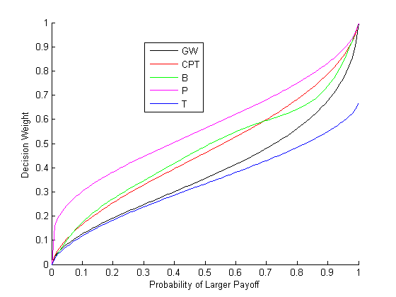
Typical Decision Weight Functions

Slide 18
Example: An application to the common consequence effect
B>A → u(1) > w(.89)u(1) +w(.10)u(5)
(1-w(.89)) /w(.10) > u(5)/u(1)
A’ > B’ → w(.10)u(5) > w(.11)u(1)
u(5)/u(1) > w(1-.89)/w(.10)
Together → 1-w(.89) > w(1-.89)
→ w(.89) + w(.11) < 1 sub additive!

Slide 19
Fails Dominance
w(p)+w(1-p) < 1 → w(1-p) < 1–w(p)
  (1-w(p))/w(1-p) > 1
  Pick y>0 : (1-w(p))/w(1-p) > u(x+y)/u(x)
A: p to get x otherwise (1-p) to get x+y, y>0
B: x for sure
(1-w(p))/w(1-p) > u(x+y)/u(x)
→ u(x) > w(p)u(x) + w(1-p)u(x+y)

Slide 20
Second stage of Weighted Utility Models:
Nonlinear transformation of cumulative probabilities
Rank Dependent Utility Theories (Quiggen, 1982; Yaari, 1987; Segal, 1990; Tversky & Kahneman, 1992)
  Explains Common Consequence , Common Ratio, Branch Independence
  Must satisfy stochastic dominance
  Fails to explain violations of stochastic dominance and event splitting
Birnbaum’s (1999) TAX model
  Wgts are nonlinear functions of probability and rank of outcomes
  Explains Common Consequence effect , Common Ratio effect
  Predicts Branch Independence, Stochastic Dominance, Event splitting
  But it uses a wgt function that is not empirically observed with binary outcomes

Slide 21
How do weighted utility models work?
Gamble F:
  .10 to win $12
  .05 to win $90
  .85 to win $98
Gamble G
  .30 to win $30
  .70 to win $100
w_{H}(98)⋅u(98)
+ w_{M}(90)⋅u(90)
+ w_{L}(12) ⋅u(12)
w_{H}(100) ⋅u(100)
+ w_{L}(30) ⋅u(30)

Slide 22
How does this explain, for example, violations of Branch Independence?
Equally likely outcomes
(4, 33, 39)
> (4, 12, 96)
Equally likely outcomes
(33, 39, 124)
< (12, 96, 124)
>
<
Put most weight on medium outcome

Slide 23
Rank Dependent Utility Weights
Gamble F:
  .10 to win $12
  .05 to win $90
  .85 to win $98
Gamble G
  .30 to win $30
  .70 to win $100
w_{F}(98) = π(.85)
w_{F}(90)= π(.85 + .05) −π(.85)
w_{F}(12)= 1 − π(.85 + .05)
w_{G}(100) = π(.70)
w_{G}(30) = 1−π(.70)

Slide 24

Decisions
Under Uncertainty

Slide 25
Ellsberg Paradox
99 balls, 33 are Red, Rest are Green and Blue
Action | Red | Green | Blue
A | 100 | 0 | 0
B | 0 | 100 | 0

Slide 26
Ellsberg Paradox
99 balls, 33 are Red, Rest are Green and Blue
Action | Red | Green | Blue
A* | 100 | 0 | 100
B* | 0 | 100 | 100

Slide 27
Ellsberg Paradox Findings
Action | Red | Green | Blue
A | 100 | 0 | 0
B | 0 | 100 | 0
Action | Red | Green | Blue
A* | 100 | 0 | 100
B* | 0 | 100 | 100

Slide 28
Problems for SEU theory
SEU(A) = p(R)u(100) > p(G)u(100) = SEU(B)
→ p(R) > p(G)
SEU(B*) = p(G)u(100) + p(B)u(100) >
SEU(A*) = p(R)u(100) + p(B)u(100)
→ p(G) > p(R)

Slide 29
Weighted Utility Model Analysis
WU(A) = p(R)u(100) > p(G)u(100) = WU(B)
→ p(R) > p(G)
WU(B*) = p(G or B)u(100) >
WU(A*) = p(R or B)u(100)
→ p(G or B) > p(R or B) non additive wgts

Slide 30
Relations between choice and prices
Basic Economic Assumption
  Choice is one measure of preference
  Price equivalent is a second measure
  A is chosen over B iff Price A > Price B

Slide 31
Certainty Equivalent Procedure
p
A
X
1-p
Y
C
B
Pick C that makes you indifferent between A and B
CE(A) = certainty equivalent for gamble A

Slide 32
Preference Reversals Between Choice and Prices (Lichtenstein & Slovic, 1971).
A: win $4 with probability 35/36;
otherwise
lose $1 with probability 1/36
B: win $16 with probability 11/36; otherwise
lose $2 with probability 25/36)

Slide 33
Preference Reversals
Joint Frequency | CE(A) > CE(B) | CE(B) > CE(A)
Choose A over B |  | High
Choose B over A | Low
Pr(A,B) > .50
Pr [ CE(B) > CE(A) ] >.50

Slide 34
Savages’ Sure Thing Principle
If state X occurs, you prefer A over B
If state Y occurs, you prefer A over B
Therefore, you prefer A over B even when X is unknown

Slide 35
Tversky and Shafir
(1992, Psychological Science)

Slide 36
Two Stage Decision Task used to Study Disjunction effect
200
Forced to play the first gamble at node G1
Do not find out about the win or loss outcome produced by this forced play
Asked to make a choice whether or not to play G2
G2
+200
-100
G1
0
200
G2
-100
-100
0

Slide 37
Disjunction Effect
  Imagine win 1st gamble :
  65% choose to play again
  Imagine lose 1st gamble:
  55% choose to play again
  Uncertain about 1st gamble:
  35% choose to play again

Slide 38
Reference point model
Different utility function used for plan vs. final
Plan
  U(G) = (.5)u(200)+(.5)u(-100)
  U(nG) = 0
Final after Loss
  U(G) = (.5)u(200 –100) + (.5)u(-100 –100)
  U(nG) = u(-100)
Final after Win
  U(G) = (.5)u(200+200) + (.5)u(-100+200)
  U(nG) = u(200)

Slide 39
Dynamic Consistency
Dynamic decision making involves using a backward induction algorithm
Plan what to do at the end of a tree and then work backwards to make decisions at the beginning of the tree
Optimal decisions depend on dynamic consistency
Planned choices, when realized, are faithfully carried out

Slide 40
Drug Abuse Decision
2
C
D
-1000
B
S
200
ND
100

Slide 41
Barkan & Busemeyer
(2003, J. Behavior Dec Making)

Slide 42
Two Stage Decision Task used to Study Dynamic Inconsistency effect
The person makes two choices
  a planned choice at G1 (before knowing the outcome)
  a final choice after experiencing the outcome after G1
200
G2
+200
-100
G1
0
200
G2
-100
-100
0

Slide 43
Dynamic Inconsistency Effect
Following actual loss
  Preference change:
  Plan_Not Play → Final_Play
Following actual gain
  Preference change:
  Plan_Play → Final_Not Play

Slide 44
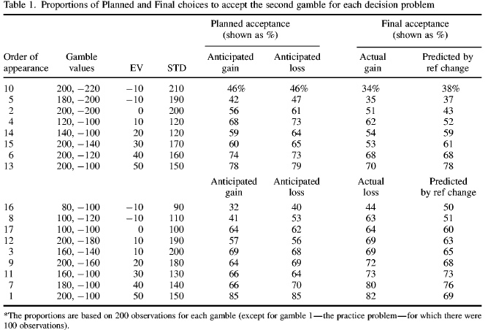

Slide 45
Reference point model
Different utility function used for plan vs. final
Plan
  U(G) = (.5)u(200)+(.5)u(-100)
  U(nG) = 0
Final after Loss
  U(G) = (.5)u(200 –100) + (.5)u(-100 –100)
  U(nG) = u(-100)
Final after Win
  U(G) = (.5)u(200+200) + (.5)u(-100+200)
  U(nG) = u(200)

